Slide 1






CUSTOMER SEGMENTATION
Python for Machine Learning - CS116
GV-TS: Nguyễn Vinh Tiệp

Slide 2
MEMBERS
Mai Anh Khoa 23520744
Hà Tuấn Anh 23520044
Võ Tạ Hữu Huy 23520655

Slide 3
CONTENTS
01
02
04
05
03
INTRODUCTION
EDA
DATA PREPROCESSING
FEATURE ENGINEERING
MODEL

Slide 4
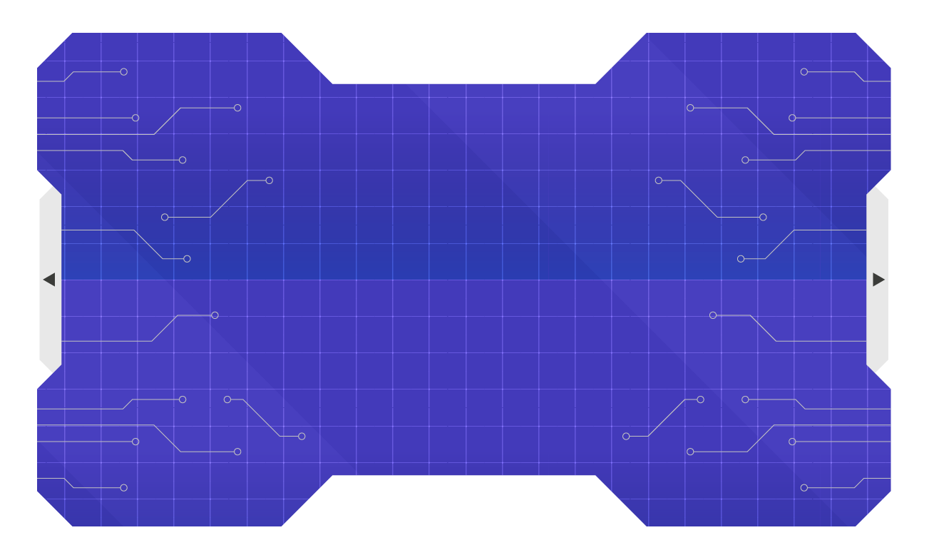
01
INTRODUCTION

Slide 5
REASONS
Customer Behavior
High Pratical Application
Flexibility and Scalability

Slide 6
DATASET
Variable | Definition
ID | Unique ID
Gender | Gender of the customer
Even_Married | Marital status of the customer
Age | Age of the customer
Graduated | Is the customer a graduate?
Profession | Profession of the customer
Work_Experience | Work Experience in years
Spending_Score | Spending score of the customer
Family_Size | Number of family members for the customer (including the customer)
Var_1 | Anonymised Category for the customer
Segmentation | (Target) Customer Segment of the customer

Slide 7
DATASET
Type of problem: Multi Classification – Customer Segmentation
Train: 8068 rows, 11 columns
Test: 2627 rows, 11 columns
Link: https://www.kaggle.com/datasets/kaushiksuresh147/customer-segmentation

Slide 8
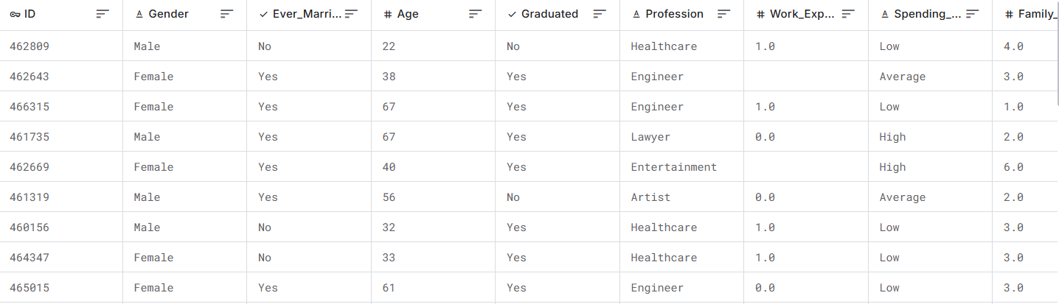
OBSERVATION
Structure: Tabular Data
Columns: Attribute of the customers
Rows: Information/Values of customers

Slide 9
OBSERVATION
Various types of data.
ID
Numerical data
Categorical data
Boolean data

Slide 10
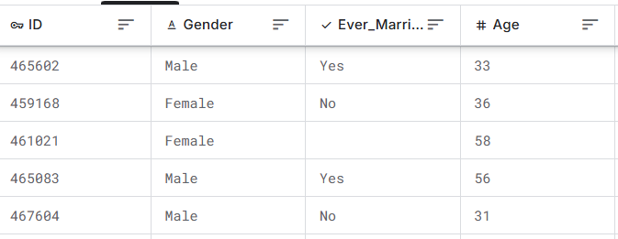
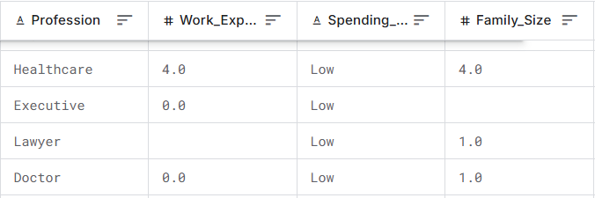
OBSERVATION
Missing data.

Slide 11
02
EDA

Slide 12
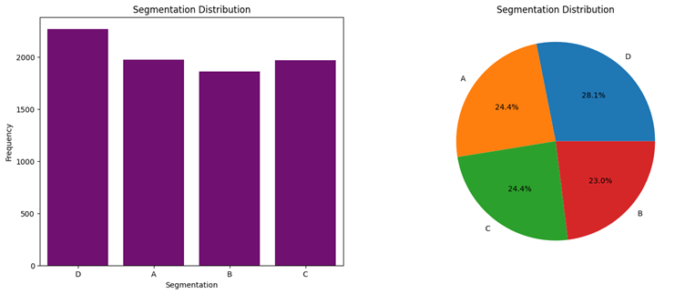
EDA

Slide 13
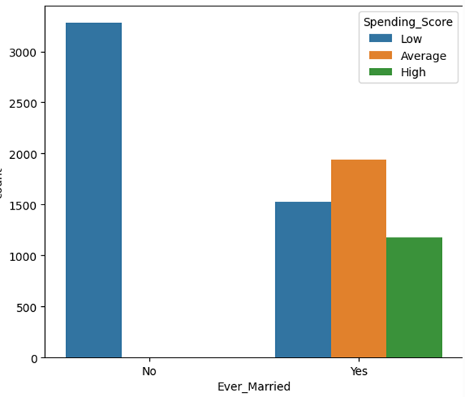
EDA

Slide 14
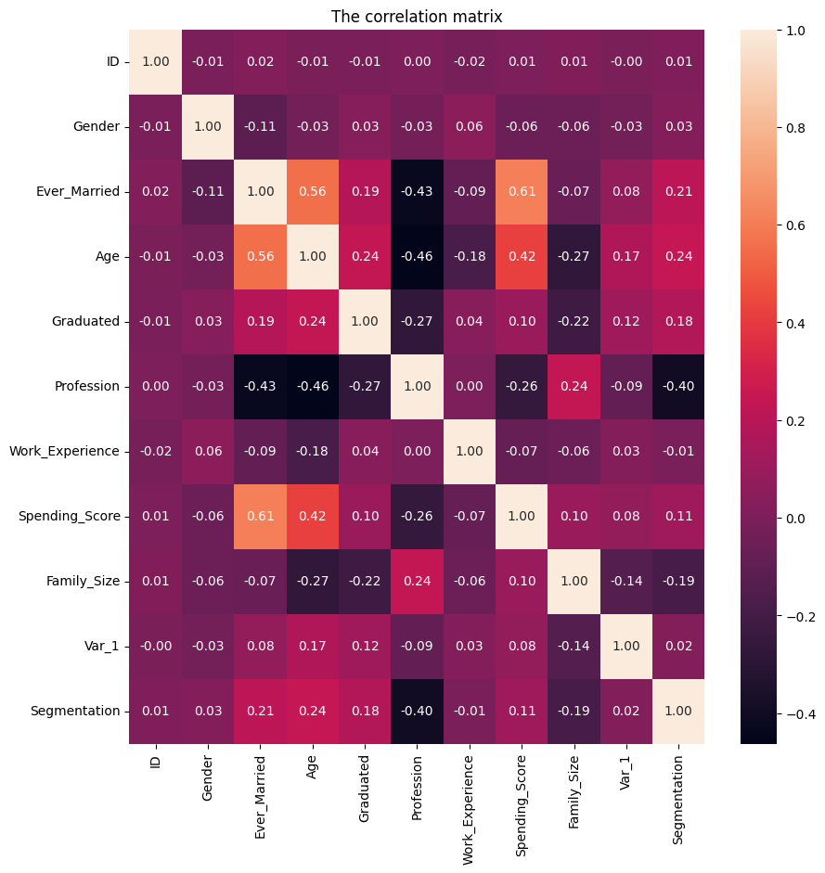
EDA

Slide 15
EDA

Slide 16
EDA
Segmentation | Profession | Moderate
 | Ever_Married, Age | Weak
 | Others | Very weak

Slide 17
03
DATA PREPROCESSING

Slide 18
DATASET
8068 rows x 11 columns
ID
462809
462643
466315
461735
462669
…
464018
464685
465406
467299
461879
Gender | Ever_Married | Age | Graduated | Professional | Work_Experience | Spending_Score | Family_Size | Var_1 | Segmetation
Male | No | 22 | No | Healthcare | 1.0 | Low | 4.0 | Cat_4 | D
Female | Yes | 38 | Yes | Engineer | NaN | Average | 3.0 | Cat_4 | A
Female | Yes | 67 | Yes | Engineer | 1.0 | Low | 1.0 | Cat_6 | B
Male | Yes | 67 | Yes | Lawyer | 0.0 | High | 2.0 | Cat_6 | B
Female | Yes | 40 | Yes | Entertainment | NaN | High | 6.0 | Cat_6 | A
… | … | … | … | … | … | … | … | … | …
Male | No | 22 | No | NaN | 0.0 | Low | 7.0 | Cat_1 | D
Male | No | 35 | No | Executive | 3.0 | Low | 4.0 | Cat_4 | D
Female | No | 33 | Yes | Healthcare | 1.0 | Low | 1.0 | Cat_6 | D
Female | No | 27 | Yes | Healthcare | 1.0 | Low | 4.0 | Cat_6 | B
Male | Yes | 37 | Yes | Excutive | 0.0 | Average | 3.0 | Cat_4 | B

Slide 19
DROP ID
8068 rows x 10 columns
Gender | Ever_Married | Age | Graduated | Professional | Work_Experience | Spending_Score | Family_Size | Var_1 | Segmetation
Male | No | 22 | No | Healthcare | 1.0 | Low | 4.0 | Cat_4 | D
Female | Yes | 38 | Yes | Engineer | NaN | Average | 3.0 | Cat_4 | A
Female | Yes | 67 | Yes | Engineer | 1.0 | Low | 1.0 | Cat_6 | B
Male | Yes | 67 | Yes | Lawyer | 0.0 | High | 2.0 | Cat_6 | B
Female | Yes | 40 | Yes | Entertainment | NaN | High | 6.0 | Cat_6 | A
… | … | … | … | … | … | … | … | … | …
Male | No | 22 | No | NaN | 0.0 | Low | 7.0 | Cat_1 | D
Male | No | 35 | No | Executive | 3.0 | Low | 4.0 | Cat_4 | D
Female | No | 33 | Yes | Healthcare | 1.0 | Low | 1.0 | Cat_6 | D
Female | No | 27 | Yes | Healthcare | 1.0 | Low | 4.0 | Cat_6 | B
Male | Yes | 37 | Yes | Excutive | 0.0 | Average | 3.0 | Cat_4 | B

Slide 20
NULL
Gender | 0
Ever_Married | 140
Age | 0
Graduated | 78
Profession | 124
Work_Experience | 829
Spending_Score | 0
Family_Size | 335
Var_1 | 76
Segmentation | 0

Slide 21
NULL
Gender | 0
Ever_Married | 140
Age | 0
Graduated | 78
Profession | 124
Work_Experience | 829
Spending_Score | 0
Family_Size | 335
Var_1 | 76
Segmentation | 0
Ever_Married: Logistic Regression

Slide 22
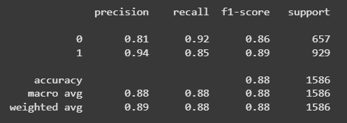
NULL
Gender | 0
Ever_Married | 140
Age | 0
Graduated | 78
Profession | 124
Work_Experience | 829
Spending_Score | 0
Family_Size | 335
Var_1 | 76
Segmentation | 0
Ever_Married: Logistic Regression

Slide 23
NULL
Gender | 0
Ever_Married | 140
Age | 0
Graduated | 78
Profession | 124
Work_Experience | 829
Spending_Score | 0
Family_Size | 335
Var_1 | 76
Segmentation | 0
- Ever_Married: Logistic Regression.
- Graduated, Var_1(~0.9%): Mode.
- Profession: Null -> ‘Other’.
- Family_Size, Work_Experience: Median.

Slide 24
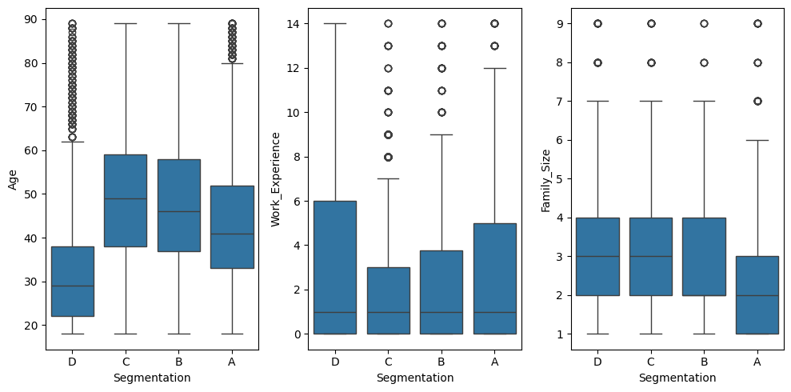
OUTLIERS

Slide 25
OUTLIERS
IQR (Interquartile Range):
Bounds: [ (Q1​−1.5×IQR), (Q3​+1.5×IQR) ]
Values: (Q1​−1.5×IQR), (Q3​+1.5×IQR)

Slide 26
ENCODING
Ordinal Encoder | Target Encoder
'Segmentation','Gender', 'Ever_Married', 'Graduated', 'Var_1', 'Spending_Score' | 'Profession'

Slide 27
ENCODING
8068 rows x 10 columns
Gender | Ever_Married | Age | Graduated | Professional | Work_Experience | Spending_Score | Family_Size | Var_1 | Segmetation
0.0 | 0.0 | 22 | 0.0 | 0.500000 | 1.0 | 0.0 | 4.0 | 3.0 | 0.0
1.0 | 1.0 | 38 | 1.0 | 1.759657 | 3.423469387755102 | 1.0 | 3.0 | 3.0 | 3.0
1.0 | 1.0 | 67 | 1.0 | 1.759657 | 1.0 | 0.0 | 1.0 | 5.0 | 2.0
0.0 | 1.0 | 67 | 1.0 | 1.680578 | 0.0 | 2.0 | 2.0 | 5.0 | 2.0
1.0 | 1.0 | 40 | 1.0 | 1.775553 | 3.782608695652174 | 2.0 | 6.0 | 5.0 | 3.0
… | … | … | … | … | … | … | … | … | …
0.0 | 0.0 | 22 | 0.0 | 1.298391 | 0.0 | 0.0 | 7.0 | 0.0 | 0.0
0.0 | 0.0 | 35 | 0.0 | 1.529215 | 3.0 | 0.0 | 4.0 | 3.0 | 0.0
1.0 | 0.0 | 33 | 1.0 | 0.500000 | 1.0 | 0.0 | 1.0 | 5.0 | 0.0
1.0 | 0.0 | 27 | 1.0 | 0.500000 | 1.0 | 0.0 | 4.0 | 5.0 | 2.0
0.0 | 1.0 | 37 | 1.0 | 1.529215 | 0.0 | 1.0 | 3.0 | 3.0 | 2.0

Slide 28
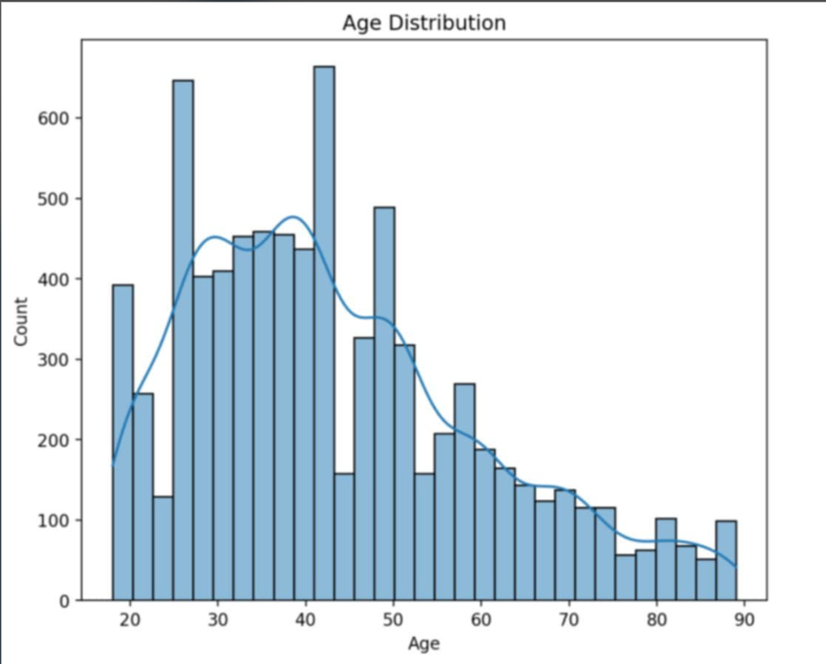
SCALING
MIN-MAX

Slide 29
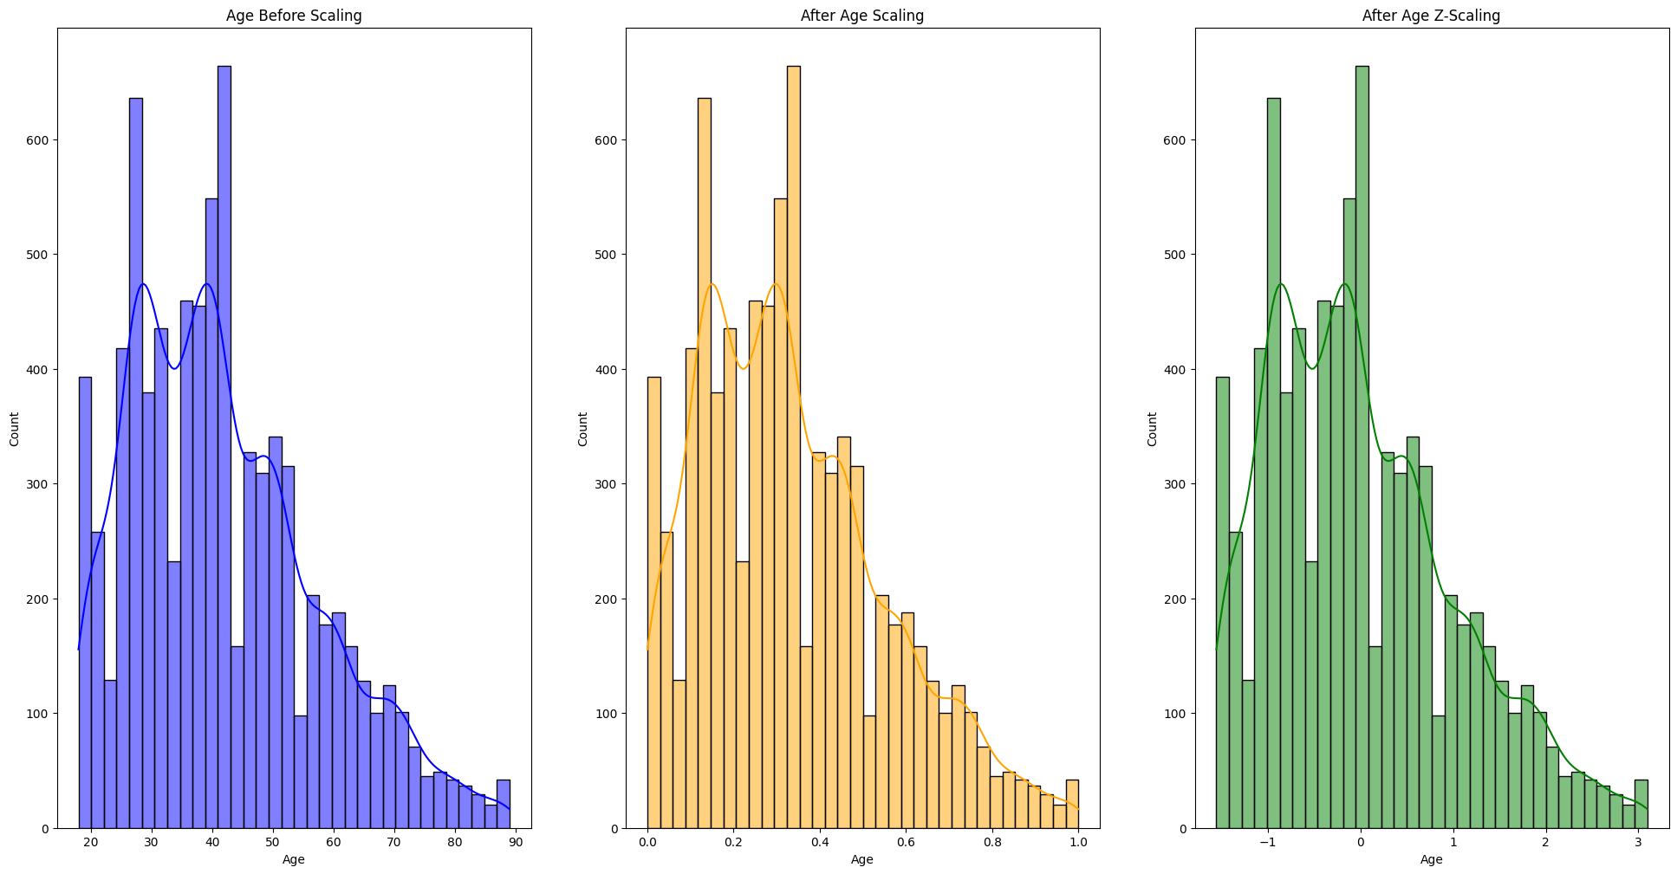
SCALING

Slide 30
04
FEATURES ENGINEERING

Slide 31
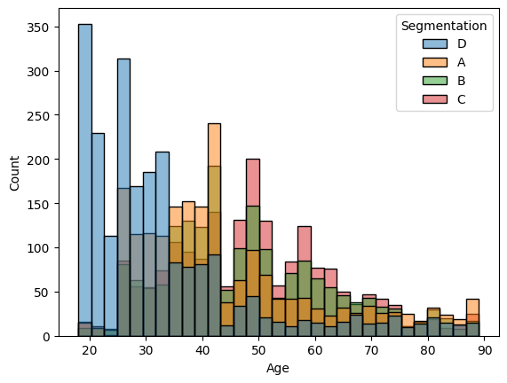
FEATURES ENGINEERING
ADD |  | MERGE
Has_Kid | Age_Teen | Married_Spending

Slide 32
FEATURES ENGINEERING
Gender | Ever_Married | Age | Graduated | Professional | Work_Experience | Spending_Score | Family_Size | Var_1 | Segmetation | Age_Teen | Has_Kid | Married_Speding
0.0 | 0.0 | 22 | 0.0 | 0.500000 | 1.0 | 0.0 | 4.0 | 3.0 | 0.0 | 1.0 | 0.0 | 0.0
1.0 | 1.0 | 38 | 1.0 | 1.759657 | 3.423469387755102 | 1.0 | 3.0 | 3.0 | 3.0 | 0.0 | 1.0 | 0.5
1.0 | 1.0 | 67 | 1.0 | 1.759657 | 1.0 | 0.0 | 1.0 | 5.0 | 2.0 | 0.0 | 0.0 | 0.0
0.0 | 1.0 | 67 | 1.0 | 1.680578 | 0.0 | 2.0 | 2.0 | 5.0 | 2.0 | 0.0 | 0.0 | 1.0
1.0 | 1.0 | 40 | 1.0 | 1.775553 | 3.782608695652174 | 2.0 | 6.0 | 5.0 | 3.0 | 0.0 | 1.0 | 1.0
… | … | … | … | … | … | … | … | … | … | … | … | …
0.0 | 0.0 | 22 | 0.0 | 1.298391 | 0.0 | 0.0 | 7.0 | 0.0 | 0.0 | 1.0 | 0.0 | 0.0
0.0 | 0.0 | 35 | 0.0 | 1.529215 | 3.0 | 0.0 | 4.0 | 3.0 | 0.0 | 0.0 | 0.0 | 0.0
1.0 | 0.0 | 33 | 1.0 | 0.500000 | 1.0 | 0.0 | 1.0 | 5.0 | 0.0 | 0.0 | 0.0 | 0.0
1.0 | 0.0 | 27 | 1.0 | 0.500000 | 1.0 | 0.0 | 4.0 | 5.0 | 2.0 | 0.0 | 0.0 | 0.0
0.0 | 1.0 | 37 | 1.0 | 1.529215 | 0.0 | 1.0 | 3.0 | 3.0 | 2.0 | 0.0 | 1.0 | 0.5

Slide 33
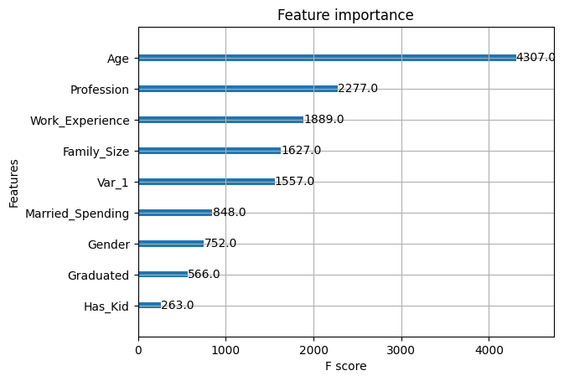

FEATURES ENGINEERING
ADD |  | MERGE
Has_Kid | Age_Teen | Married_Spending
Keep Has_Kid

Slide 34
05
MODEL

Slide 35
MODEL
Logistic
Regression
Random Forest
XGBoost
& LightGBM

Slide 36
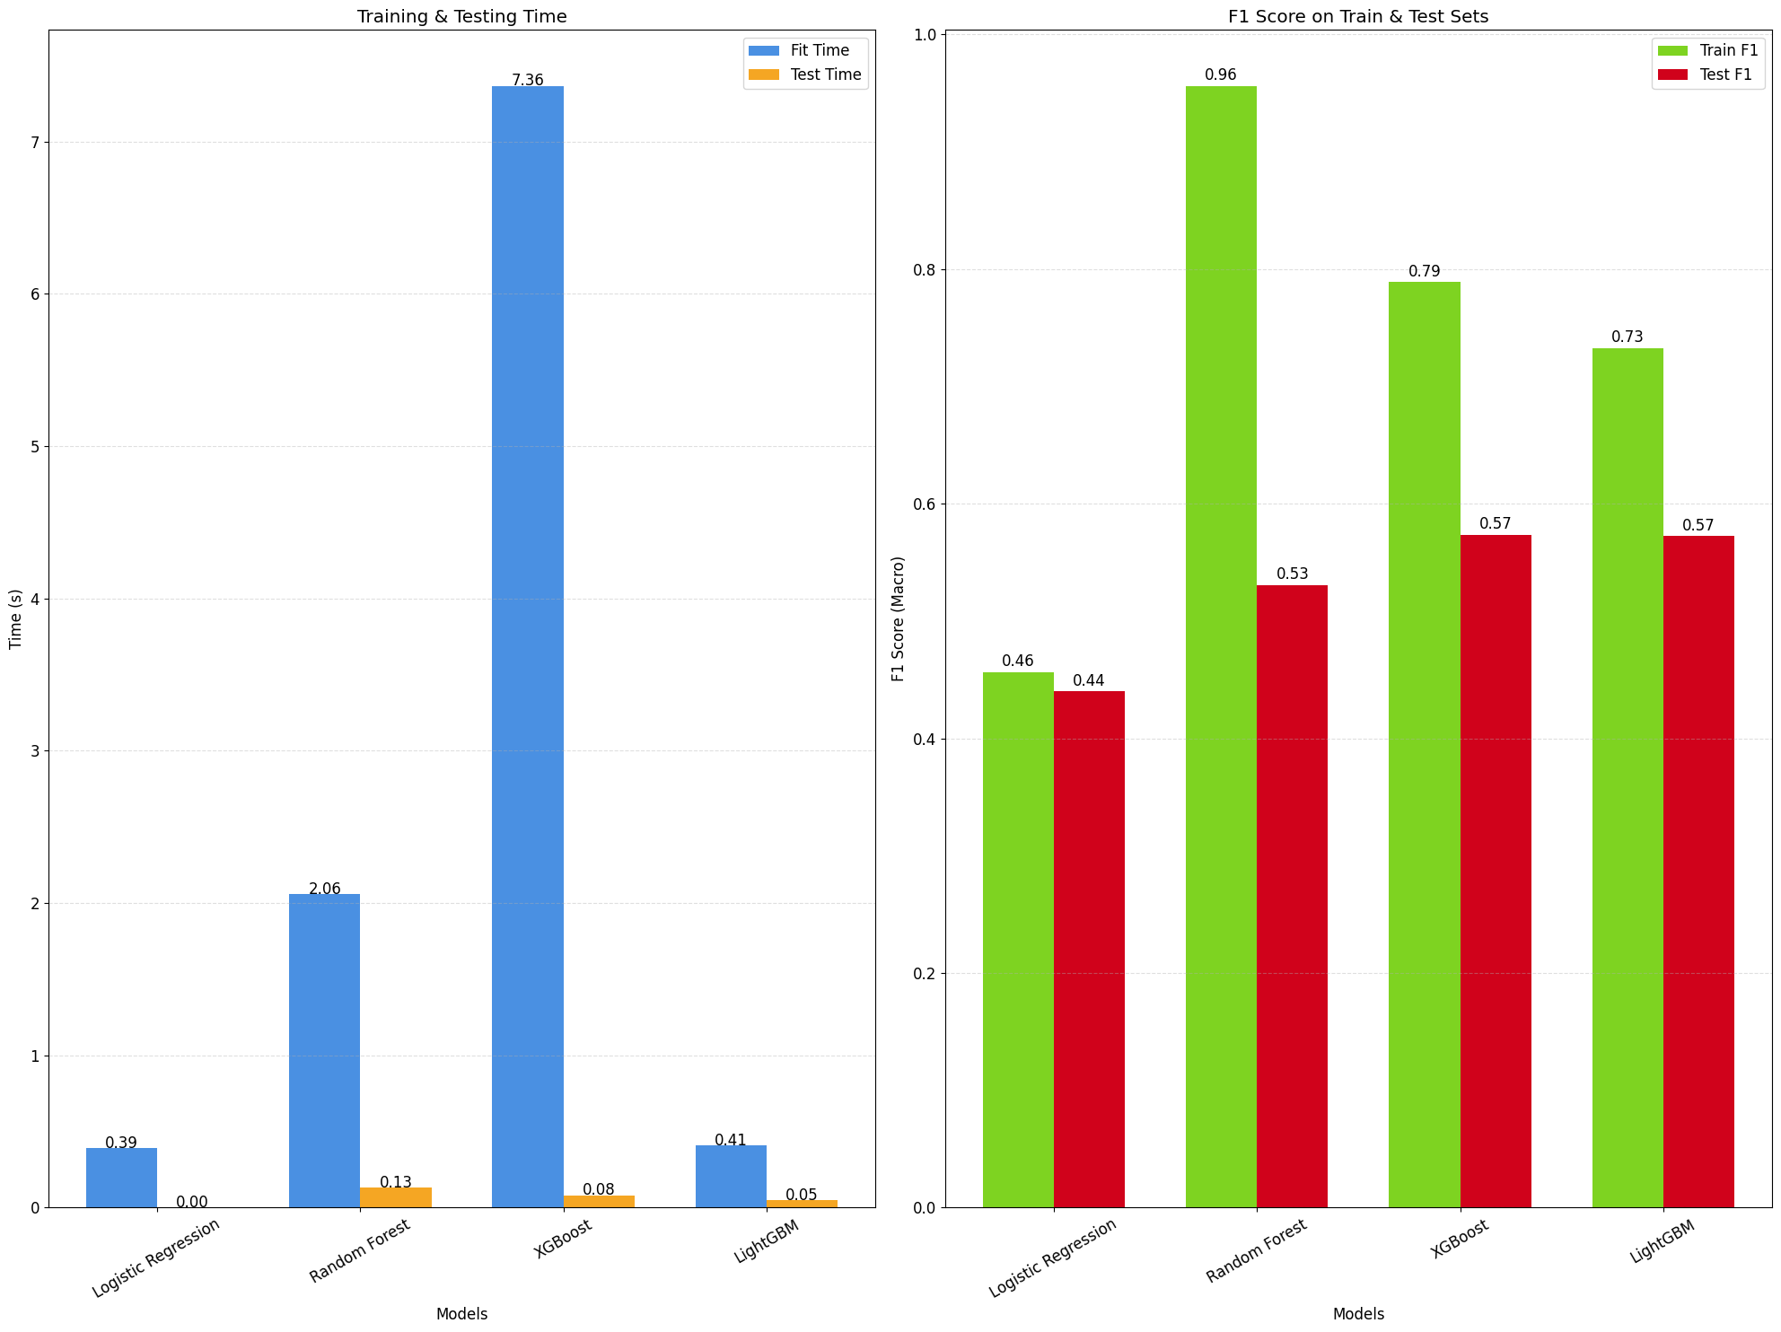
MODEL VALIDATION

Slide 37
MODEL TUNING
Grid Search | Linear Regression
Random Search | Random Forest
Optuna | XGBoost & LightGBM

Slide 38
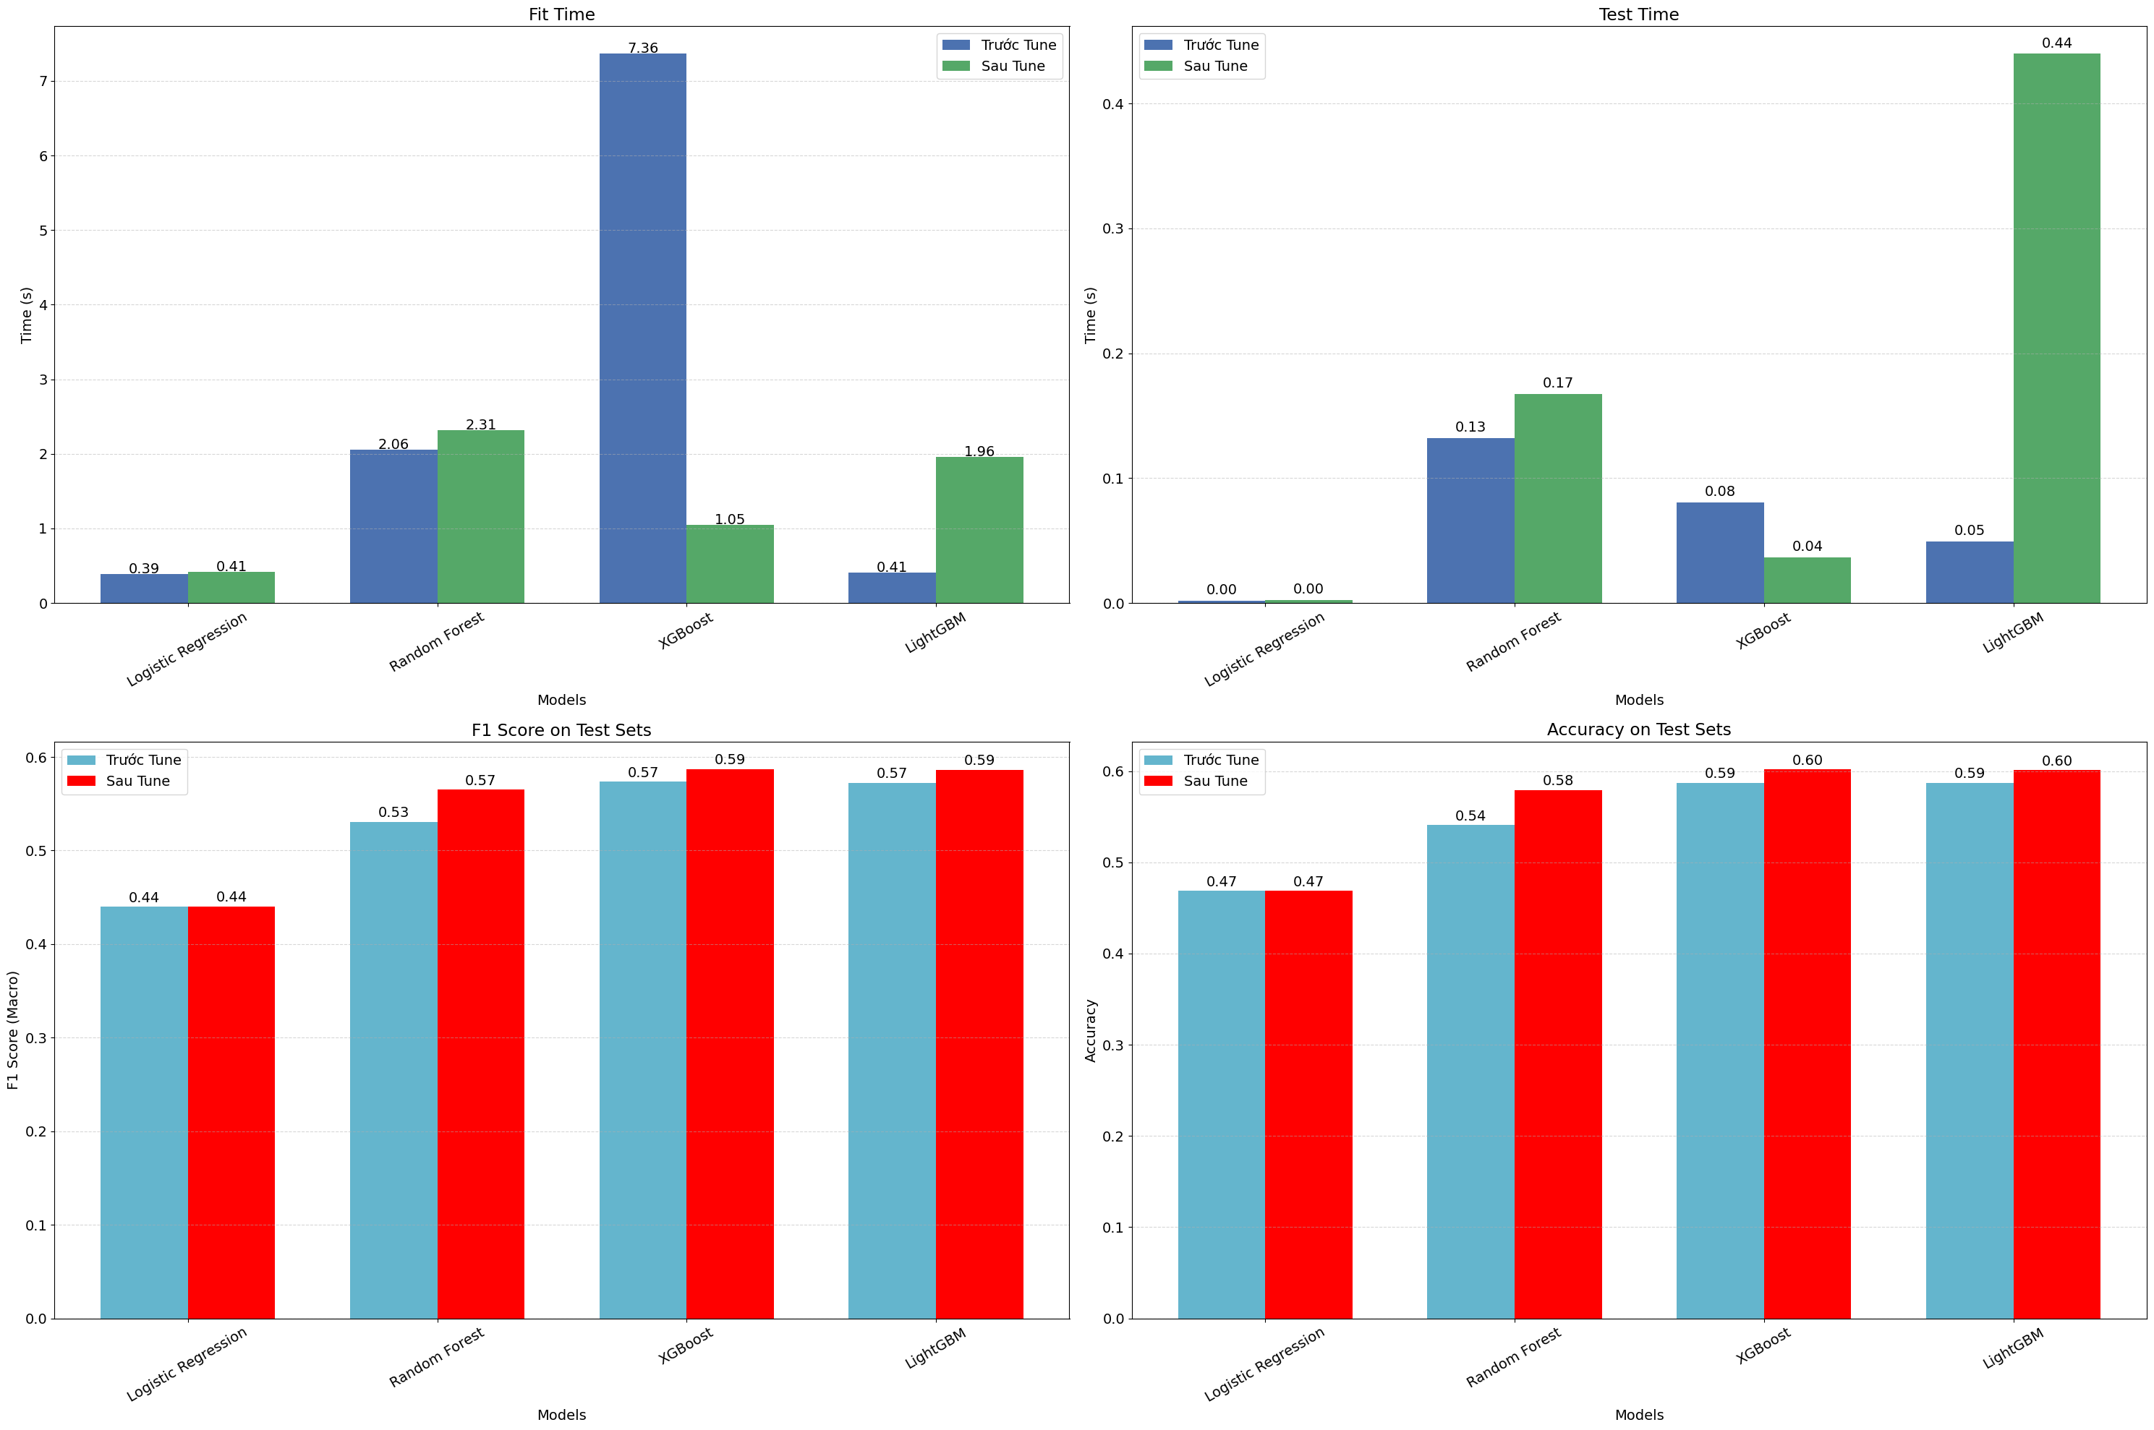
MODEL TUNING

Slide 39
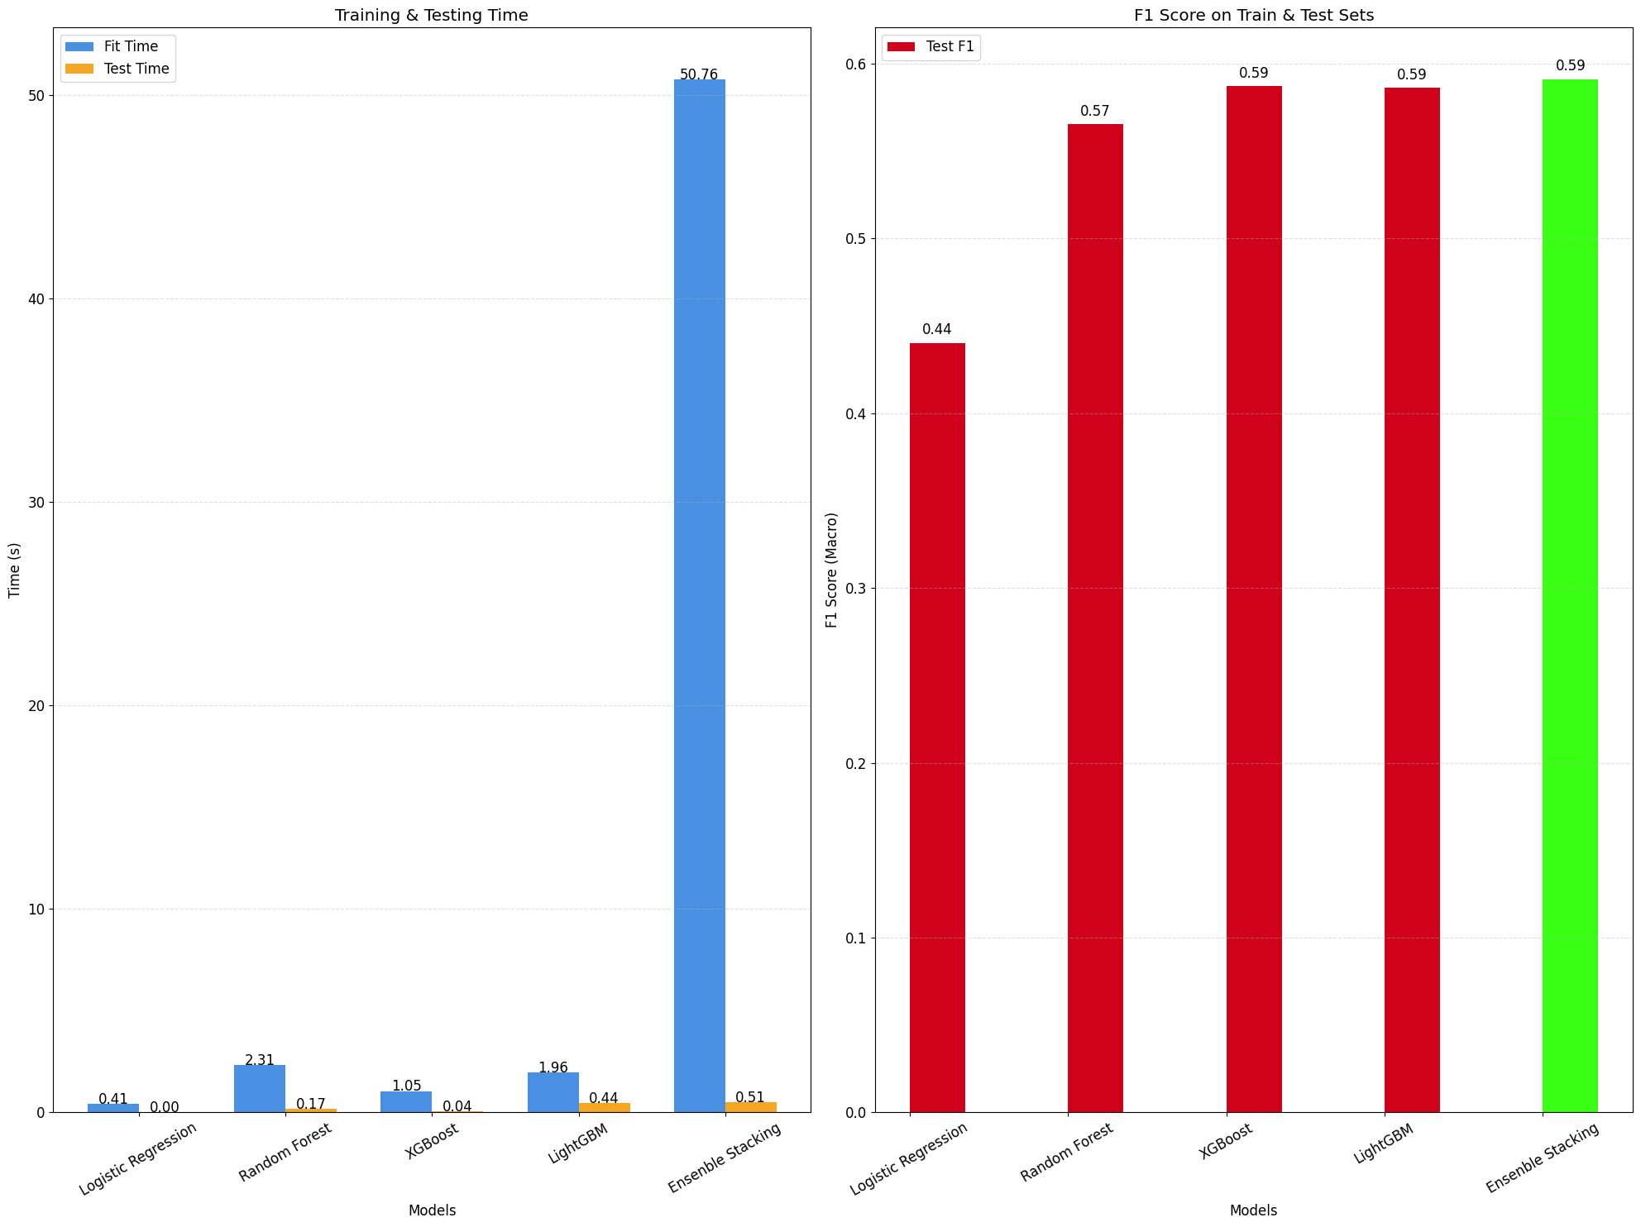
ENSEMBLE MODEL (STACKING)

Slide 40
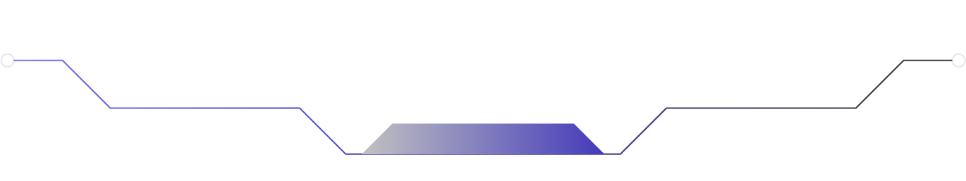


Slide 41


THANK YOU FOR YOUR LISTENING

